Slide 1
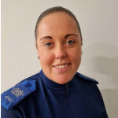
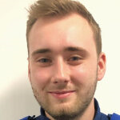
Sedgemoor South East, AW056
SERVE. PROTECT. RESPECT.
SERVE. PROTECT. RESPECT.
Police Community Support
Officer
6761 Georgia Coles
07889 659466
Police Community Support Officer
8127 Benjamin Simpkin
07889 659932
@ASPSedgemoor
Contact us
: https://www.avonandsomerset.police.uk/your-area

