Slide 1
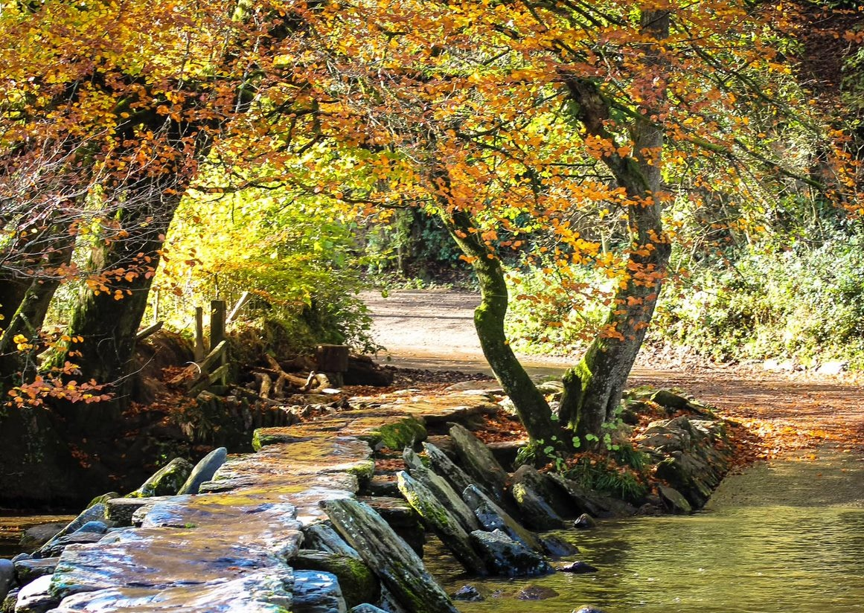
Voluntary, Community and Social Enterprise opportunities of Unitary
Katherine Nolan – CEO, Spark Somerset
Charlotte Jones – Volunteering Development Manager, Spark Somerset
Olly Clabburn – Research Lead
Jenny Hannis – Voluntary Sector Advisor

Slide 2



Notes:
Hello
Welcome to this Spark webinar
Will send slides by email after the webinar
Situation is new – all making it up as we go along. Every community is different, so will all being doing things a bit differently but there is still a lot we can learn from each other
This is a brief overview of the different alternatives to using cash
We're not finance experts, we're just showing you the options and you will need to look into these in more detail
Zoom controls – you are muted and your cameras are off, you should be able to see me and my screen, raise hand feature when I ask questions,

Slide 3
  Who are Spark Somerset?
  The Somerset VCSE – diverse, vibrant and flexible
  Community Networks – asset-based community development
  And now your turn
Notes:
Welcome
Run through discussion points
Q & A’s
We will be sending out a survey - Please indicate if you’re happy for us to share contact details with others to allow for networking

Slide 4
Who are Spark Somerset?
Our aim is to inspire strong and sustainable communities through voluntary and community action.

Slide 5
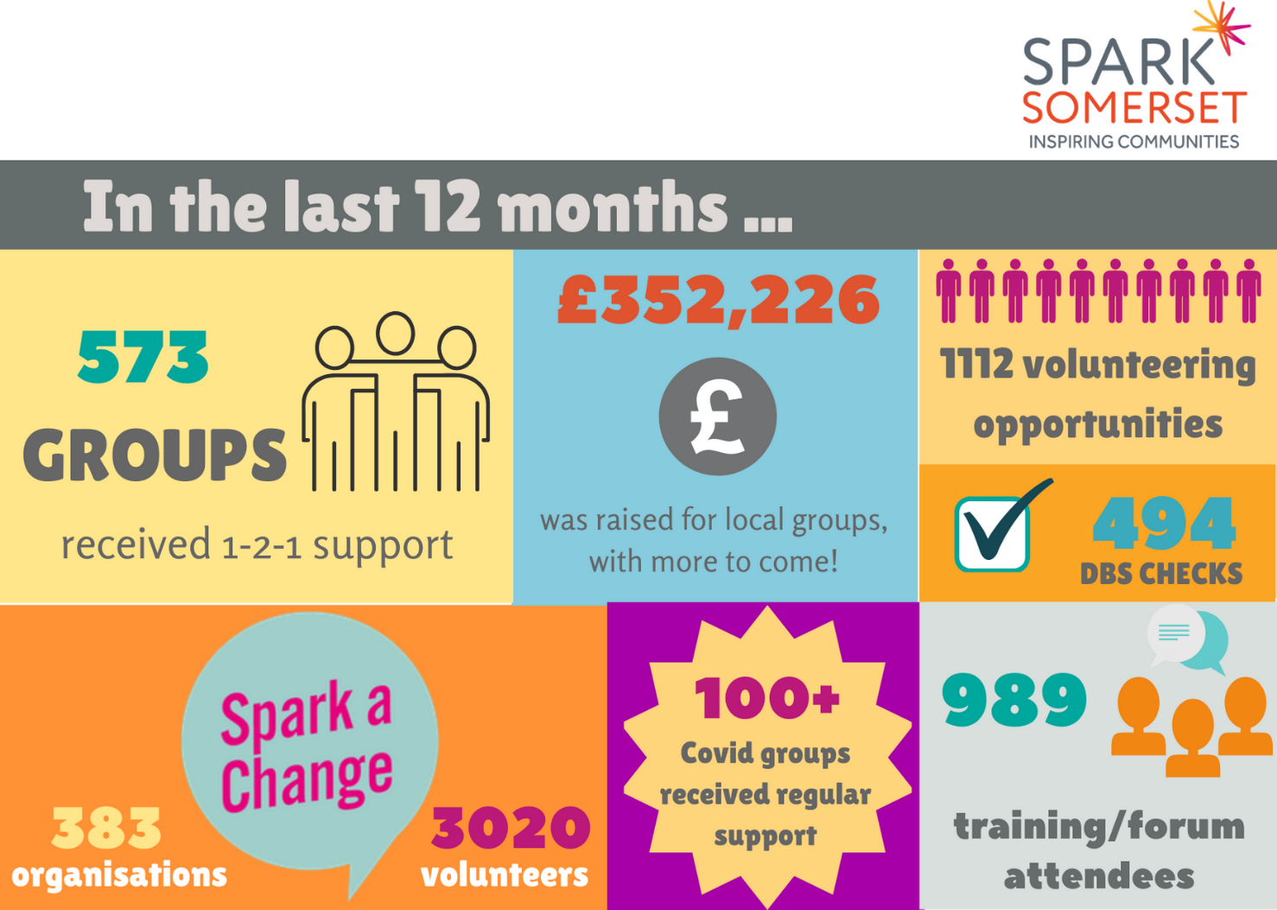

Slide 6
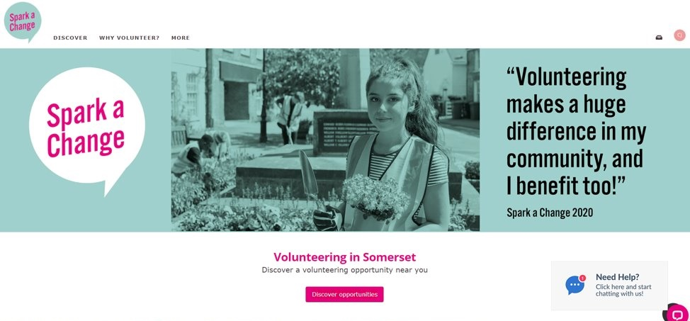
344 organisations and 1369 volunteers. 100 people a day accessing the portal
69% of volunteers aged 55 and under

Slide 7
Led Countywide Men’s Shed forum, Covid Confident and Food forums
Supported 100+ new Covid groups
44 additional forums with 628 attendees
25 training sessions with 361 attendees
Recruited 100+ Covid Champions and Vaccine Buddies
Represent the voluntary sector on key Boards, forums and events (including Somerset People Board, Local Resilience Forum, VCSE strategic lead for volunteering and ICS development).
Supporting 79 Active Living Groups, providing regular newsletters and phone support.
Brand new Digital Inclusion Project, in partnership with Somerset
NHS Foundation Trust and Barclays

Slide 8
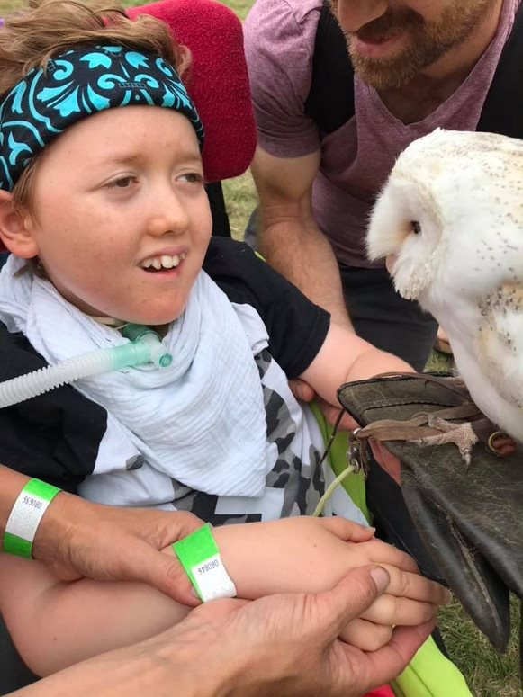
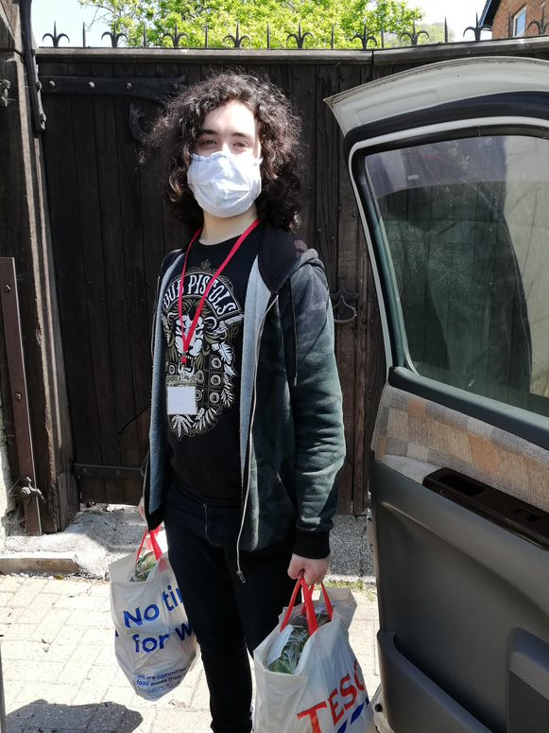
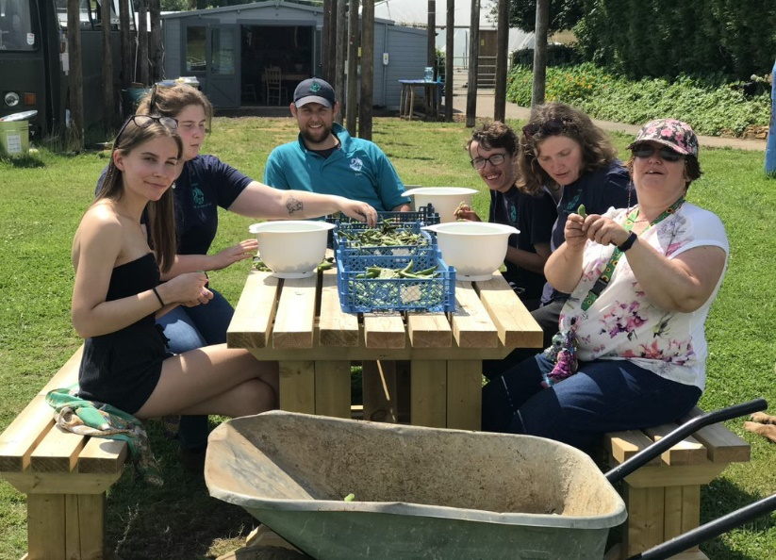
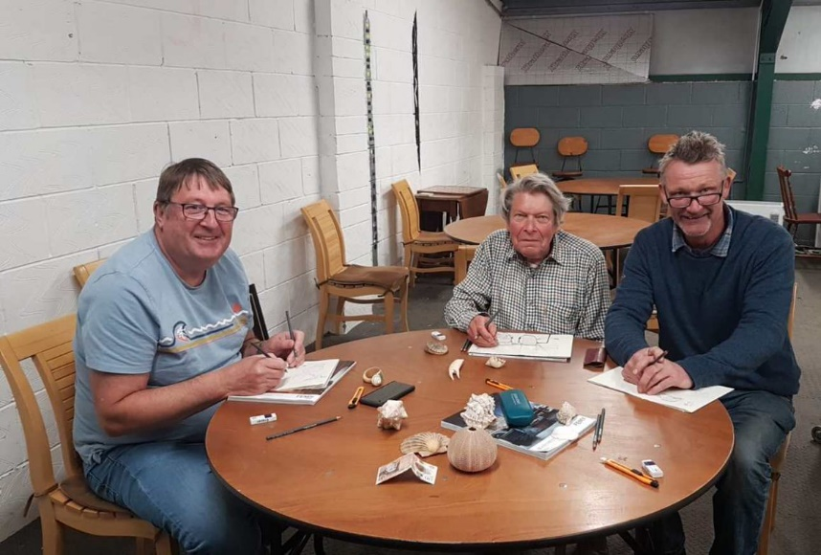
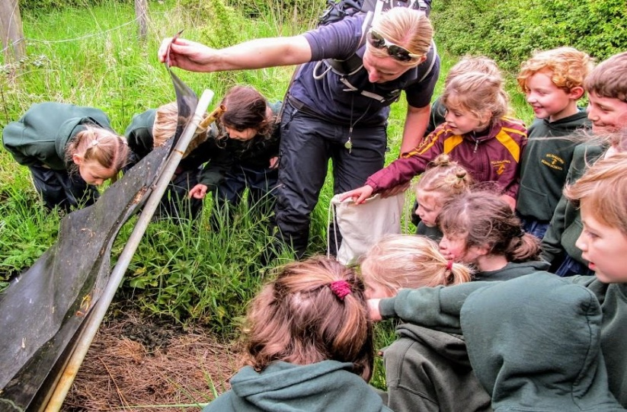
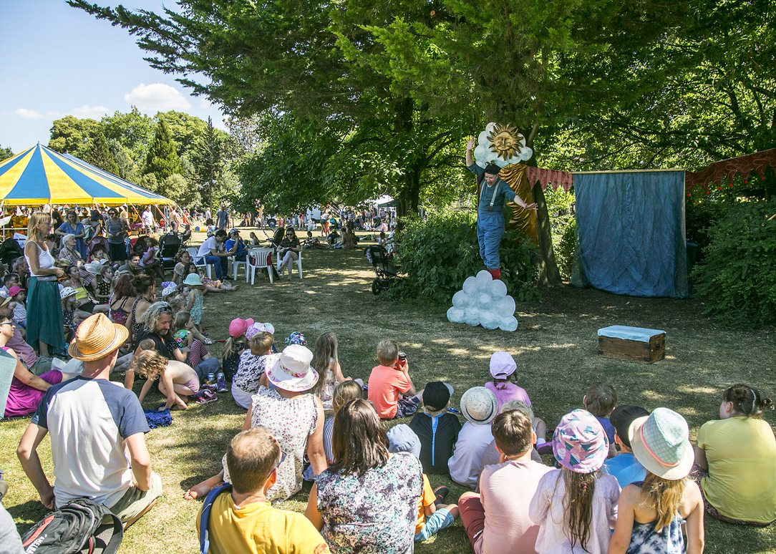
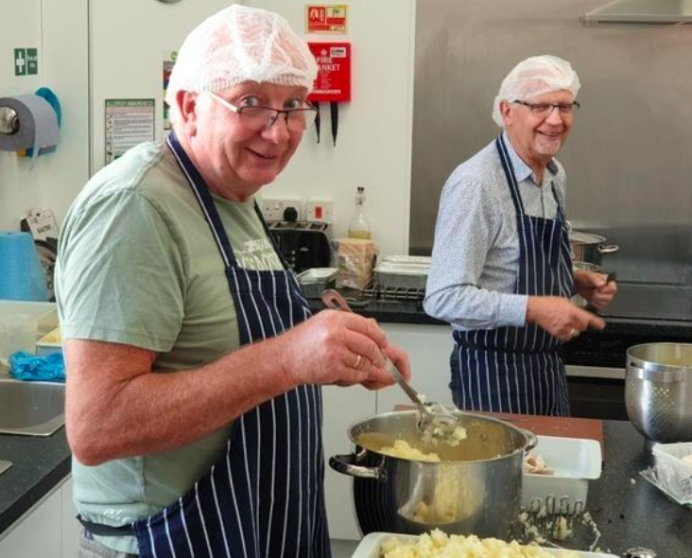
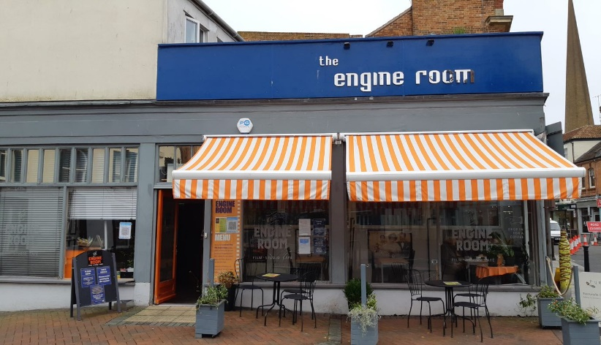
A year like no other
Notes:
The effect of COVID-19 on people and communities across Somerset has clearly illustrated how in touch local groups and charities are with the needs of their communities. The pandemic has highlighted the importance of local knowledge, adaptability and responsiveness – all the things that the VCSE is known for. Somerset is so lucky to have such a strong, diverse and vibrant VCSE (Voluntary, Community and Social Enterprise) sector. Embedded within their communities, the majority of VCSE organisations in Somerset work at a very local level, supporting people on the doorstep. They are adept at accessing hard to reach and vulnerable groups; able to advocate on their behalf and provide practical and emotional support. Since the pandemic hit in March 2020, people have faced some of the most difficult times of their lives. From the initial lockdown to the ‘learning to live with it’, from the social isolation to the challenges of home schooling, from the fear of losing loved ones to the reality of losing jobs. Within days, community groups across the County – formal and informal – networks, neighbours and social enterprises, rallied round to help people in need. At a time of crisis, the VCSE and ‘community action’ really came into its own. In a year like no other we have been overwhelmed by the response of voluntary groups and communities. It has been a real privilege to work with such amazing organisations and fantastic volunteers, especially during such challenging times. Never more has our VCSE sector been needed.

Slide 9
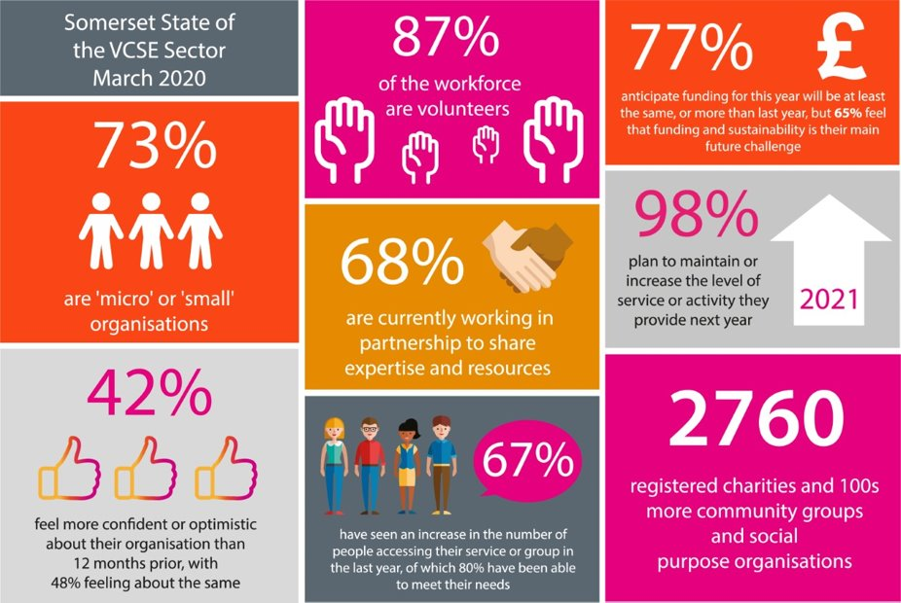
Notes:
Embedded within their communities, the majority of VCSE organisations in Somerset tend to work at the ‘hyperlocal’ level, often acting as ‘first responders’ to people in need. They are adept at accessing hard to reach and vulnerable groups; able to advocate on their behalf and provide practical and emotional support – particularly for those who are under-served by statutory services. Many of these groups also support the prevention agenda, recognising the importance of early intervention and population health, and the positive effects that this can have on the wider community. Distinctive and diverse, local groups support individuals in need who don’t require a formal ‘intervention’, are there for those who fall between the cracks of statutory services and also work with people who are on the road to recovery, connecting them back into social activities. More recently, VCSE organisations are working in partnership with statutory colleagues through initiatives such as social prescribing and Open Mental Health.

Slide 10
15 to 20 new Local Community Networks (LCNs) established reaching every corner of Somerset to give local people the chance to shape their own communities
The value of place - it requires trust, empowerment and an element of risk-taking
Provides an opportunity to see more dispersed democracy and meaningful engagement, less bureaucracy, innovation and more joined up thinking at a local level.
Increased and dispersed democracy; meaningful engagement with communities.
Asset-based community development work with, existing networks, such as primary care networks, town and parish councils, community hubs and communities of interest.
The VCSE sector is always a crucial point of stability for our local communities - a strong and vibrant VCSE will be key.
Notes:
LCNs - These will have real constitutional powers to scrutinise, impact and take decisions. Work with partners to encourage more joined up thinking, at a local level to encourage, inspire and enable communities. Work in partnership to provide the best outcomes for our communities.
continued investment in voluntary sector infrastructure and services will be key - both at a Countywide, district, town, village and micro level.

Slide 11
“There are things that only a community can do, that they’re uniquely competent to do. There are also things that only government can only do… It’s really important that government doesn’t do what the community can do, but where a community needs help – help them. And where a community needs the government to do its job, get on and do it. What we’re actually seeing is decades of the net result of government doing stuff that communities can do best. So they’ve grown rusty.
Cormac Russell, Nurture Development
“No society has the money to buy, at market prices, what it takes to raise children, make a neighbourhood safe, care for the elderly, make democracy work or address systemic injustices… The only way the world is going to address social problems is by enlisting the very people who are now classified as ‘clients’ and ‘consumers’ and converting them into co-workers, partners and rebuilders.”
Edgar Cahn

Slide 12
Asset-based community development changes the relationship between a local authority, its citizens, and communities by focusing on ‘what’s strong, not what’s wrong’.
Local partnerships: ABCD is not something that councils do alone. Rather, it’s about playing a part within an ecosystem, working with partners with similar principles or desired outcomes. This could include other directorates within the local authority, VCSE organisations, the constabulary, as well as local groups and residents.
Community Builders: a person within an existing, trusted organisation that is based and operates at a neighbourhood level.
Community Connectors: local people with a gift or passion they are encouraged to use/share.
Asset mapping: a collective process that creates an inventory of local assets and strengths.
Small sparks funding: micro-grants awarded to communities and individuals to create projects that benefit the whole area.
Asset-Based Community Development for Local Authorities:
How to rebuild relationships with communities through asset-based approaches
NESTA, September 2020

Slide 13

Discussion

Slide 14
What has been the impact of the pandemic on community-based groups/ organisations in Somerset?

Slide 15
What are the current needs and priorities of Somerset-based communities as we emerge from the pandemic?

Slide 16
What are the opportunities and challenges
from Unitary for the VCSE?
What are the opportunities?
What are the challenges?
What do parish & town councils hope for from a new Unitary Council for Somerset?

Slide 17
Information
CASE STUDY
www.sparksomerset.org.uk
www.sparkachange.org.uk
https://www.youtube.com/watch?v=Elc0ddBotj0
support@sparksomerset.org.uk

Slide 18
Thank you

