Slide 1
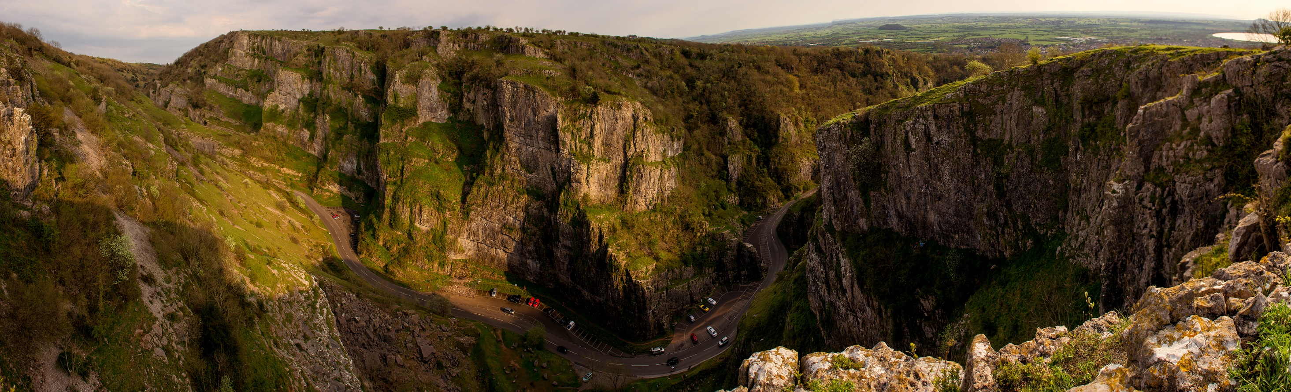
Local Community Networks
Alyn Jones – Director of Economic and Community Infrastructure Operations at SCC

Slide 2
Seven principles of community building
(“Rekindling Democracy“, 2020 C Russell)
Find a trusted local association with sufficient infrastructure to act as host for the work
Start by making the invisible visible; don’t be helpful, be interested
Understand that effective community building goes at the speed of trust
Start with what’s strong to address what’s wrong and make what’s strong stronger
Know that community connectors are critical
Recognise that the optimum population size of a neighbourhood is three to five thousand residents
Keep your focus on growing a culture of community, not converting people to asset-based community development (ABCD) or any other approach

Slide 3
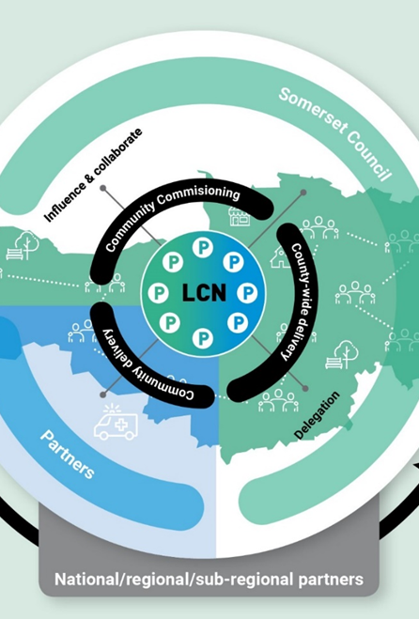
Local Community Networks (LCNs)
Designed and shaped by Communities, Town, Parish and City Councillors, partners and the unitary council shadow or implementation executive.
“Putting our communities at the heart of everything we do – thinking strategically and acting locally”

Slide 4
Local Community Networks (LCNs)
Not new – already successful in other unitary councils
Constituted committees of council with real decision making powers
Between four and nine unitary councillors on each LCN joined by local town & parish councils, police, health, education and other partners
A forum for local discussion, action, oversight, listening, consultation
Local data and community evidence driven - addressing local issues and priorities

Slide 5
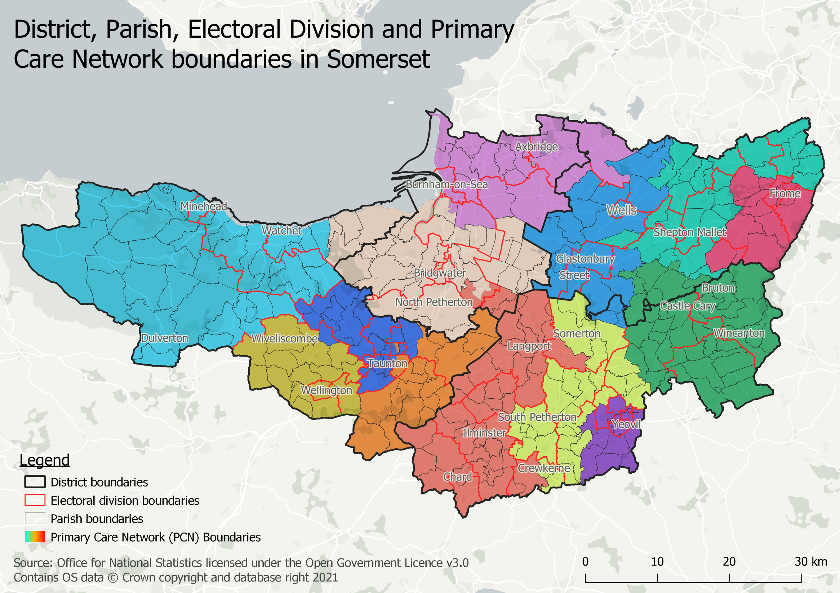
PCNs

Slide 6
LGR Advisory Board and work on LCN definition
Guiding values for the definition of LCNs are summarised as:
LCN design to be co-produced with communities and partners
LCNs to be set up in accordance with the business case, including the seven recommendations from the Somerset Association of Local Councils (SALC) and the Society of Local Council Clerks (SLCC) and the seven Russell principles
LCNs to be designed around Somerset’s natural communities
Each LCN to have a detailed Joint Strategic Needs Assessment (JSNA) identifying the community profile and social, economic and health challenges in those communities
LCNs to develop their objectives and work programme from this evidence base and local priorities

Slide 7
LGR Advisory Board and work on LCN definition
Design principles for the definition of LCNs are summarised as:
LCNs will be “Committees of Council” with powers including spending
LCN boundaries will be constructed around parish boundaries
LCNs will convene within their geography or virtually
A unitary division and parish council to sit within one LCN area (however, clusters of parishes could work together on other shared priorities)
LCN budgets to include revenue and capital expenditure for agreed local priorities
Each LCN to be supported by a dedicated LCN manager
A unitary council Director or Senior Manager to champion each LCN and its community
Any spending decision by the LCN must carry the support of the majority of unitary councillors
City, town and parish councils to be represented on the LCN. One representative each. Other representatives from the voluntary sector, business, health, education, police and fire
LCNs to work with partners and the city, town and parish councils to deliver their vision, objectives and priorities for their places across the community.
LCNs to work within the agreed policy framework and approved decisions of the new unitary council
LCNs will need to work collaboratively at the Primary Care Network (PCN) level for some cross-boundary health and social care issues

Slide 8
7 Recommendations from Somerset Association of Local Councils and SLCC
A charter for Somerset
Setting out rights and responsibilities, expectations and new possibilities and ways of working between the unitary authority and parish and town councils.
Local ownership and devolution
Parish and town councils to be involved in determining the methodology behind the devolution of assets and application of the principle of devolution “by request”
Localism and solutions
The unitary and parish and town councils to commission a “Somerset Guide to Localism” including good examples, outcomes and meaningful partnerships
Local governance
Parish and town councils to be involved in establishing the boundaries, brief, representation and procedures of LCNs from day one.
Local presence
LCNs to have dedicated and supported senior staff presence based locally. Representatives of parish and town councils to be involved in the appointment of the staff
Trust and partnerships
build trust, a five-year joint cultural and development programme for staff and members be established.
Parishes working together
Parish and town councils need to run a campaign to ensure that their voices are heard loud and clear in the run up to, implementation and subsequent working of the new unitary council

Slide 9
Advisory board work to do
Identify the number of LCNs
Define proposed geographies
Consult on the above
In parallel with the above, establish the pilots to test a range of issues as part of LGR implementation
Define the roles of staff and members involved in the LCNs

Slide 10
LCN Pilots as part of LGR implementation
Up to four pilots running by Dec 21 to design, experiment and test around the following themes
Local highways and street scene (SW&T Exmoor panel area)
Economic development and social mobility?
Health and wellbeing?
Children, young people and families?
LCN underpinning evidence; JSNA data and analysis plus local qualitative evidence
Locality agreements between the new unitary council and the parish councils
Alternative staffing models

Slide 11

Questions & Answers

